Slide 1
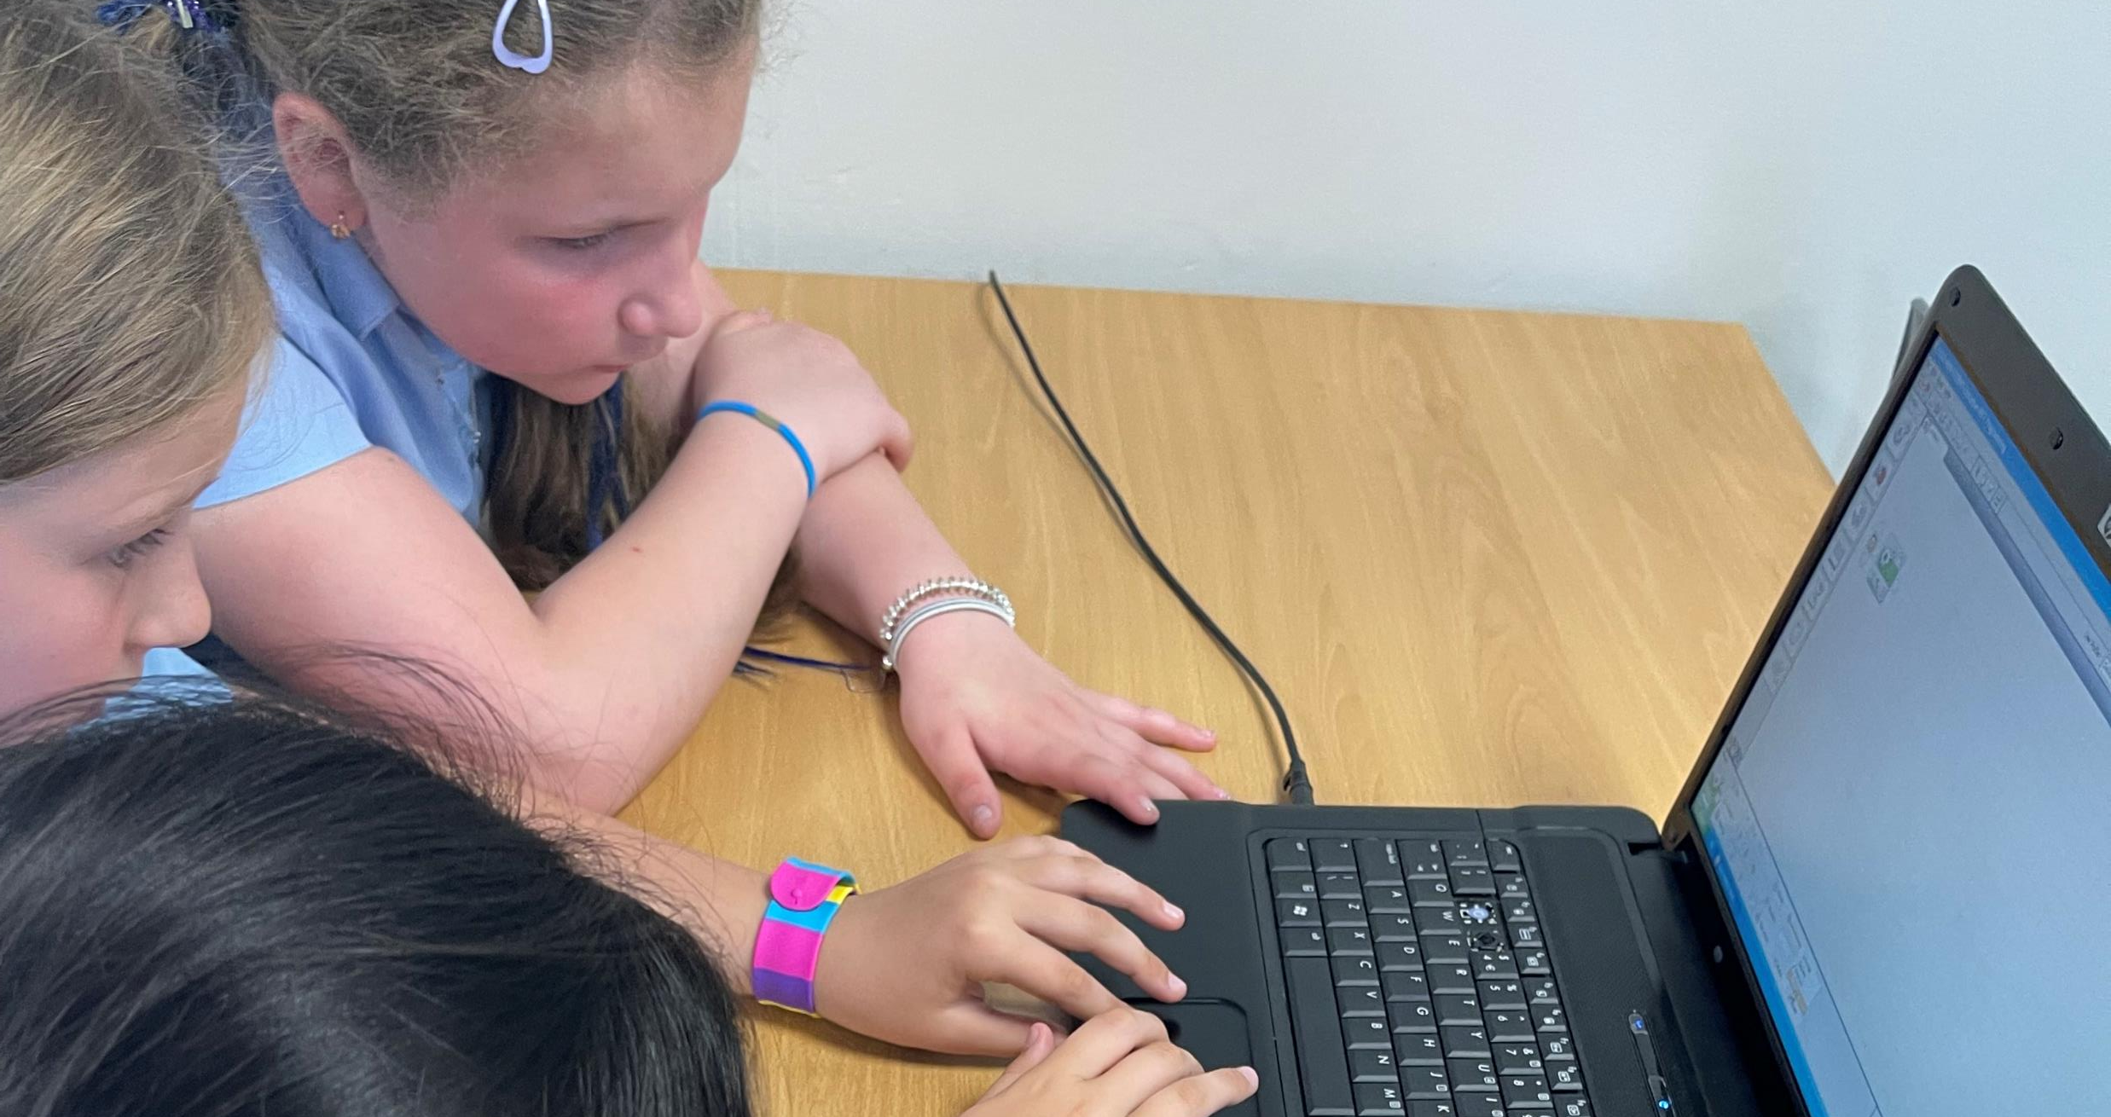

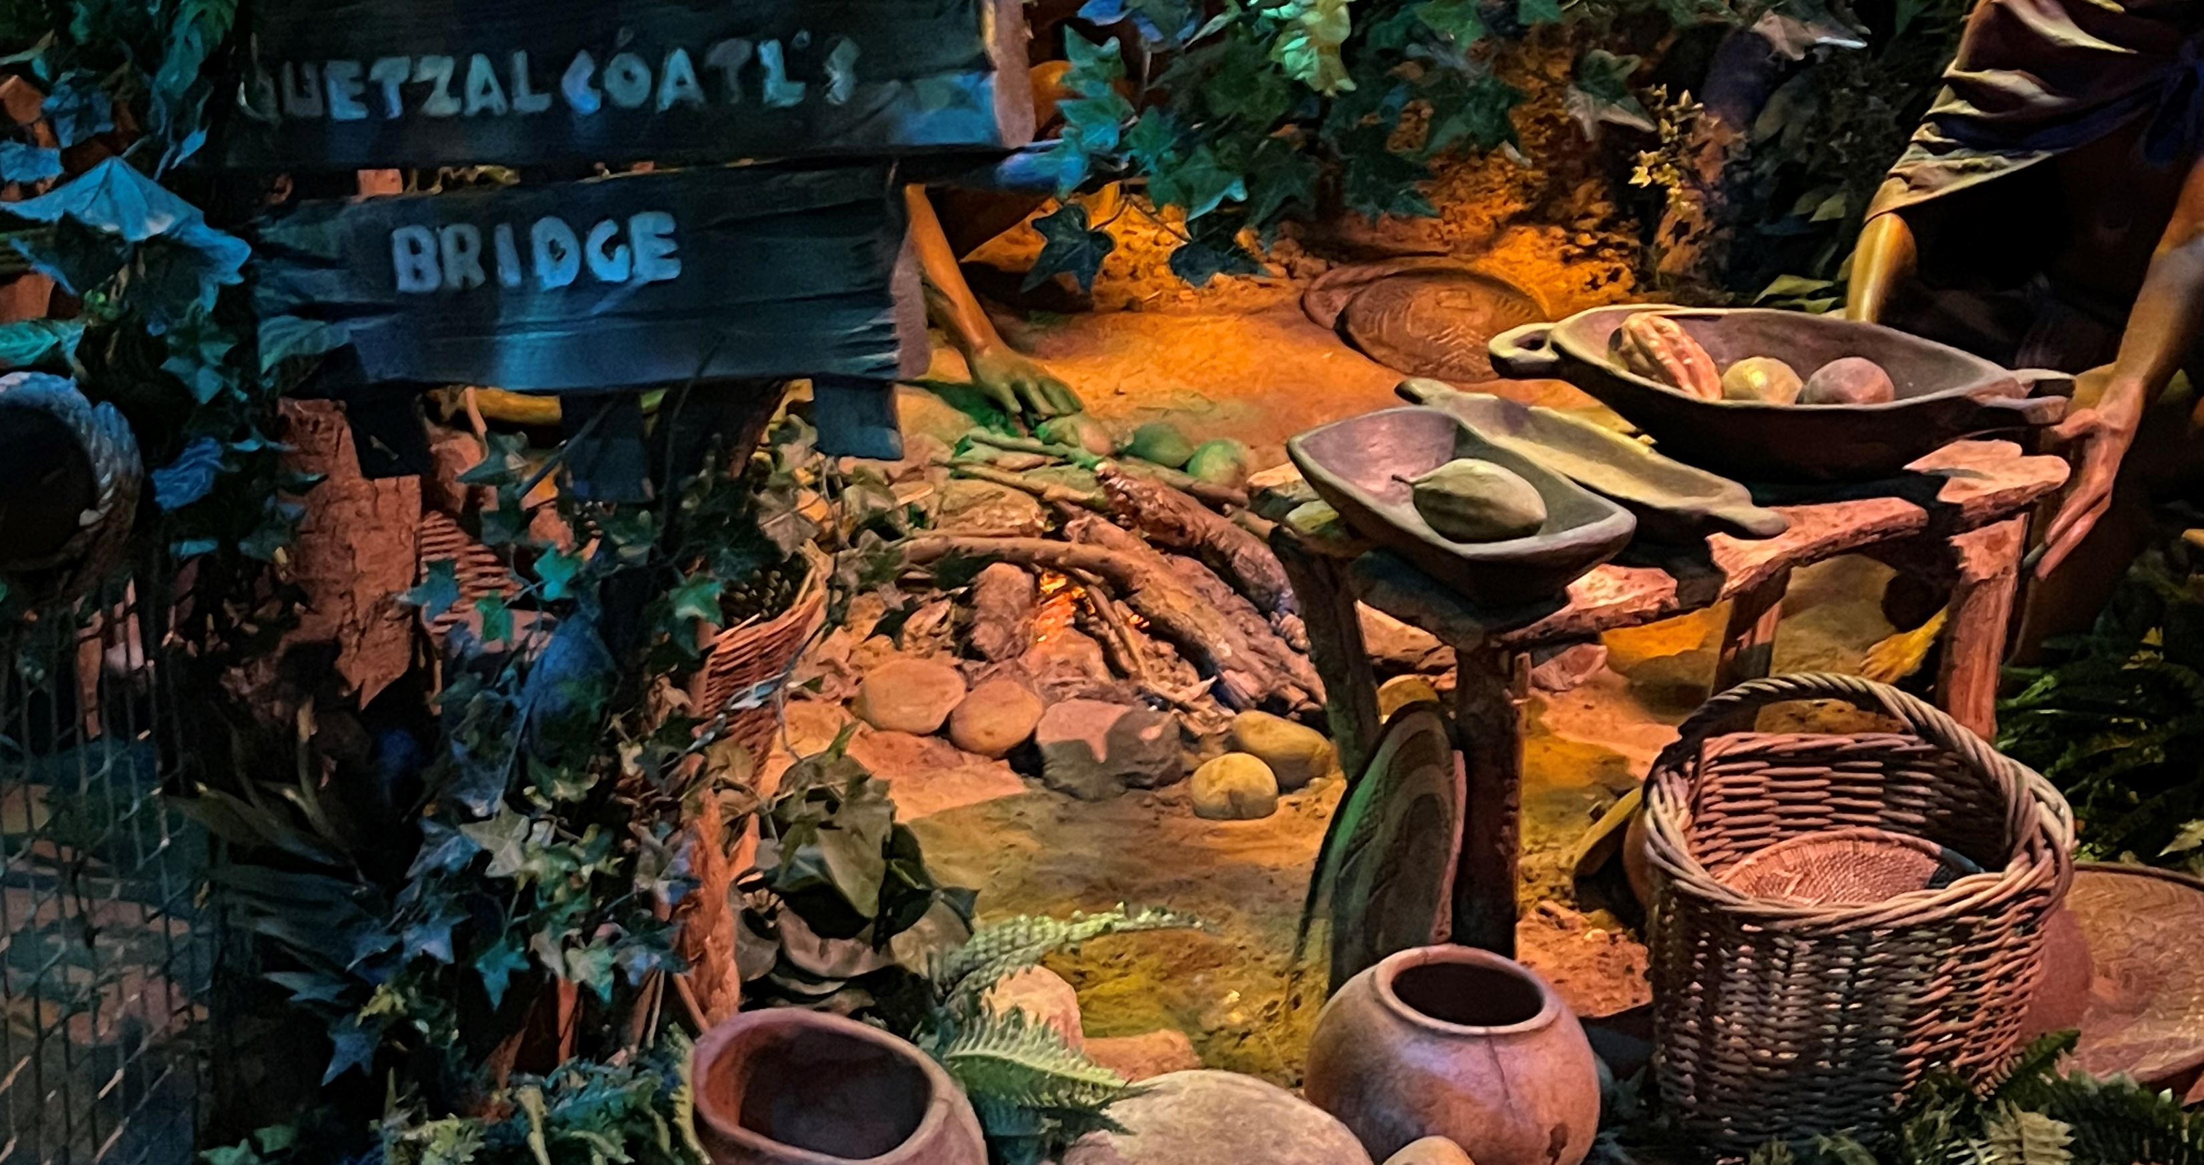
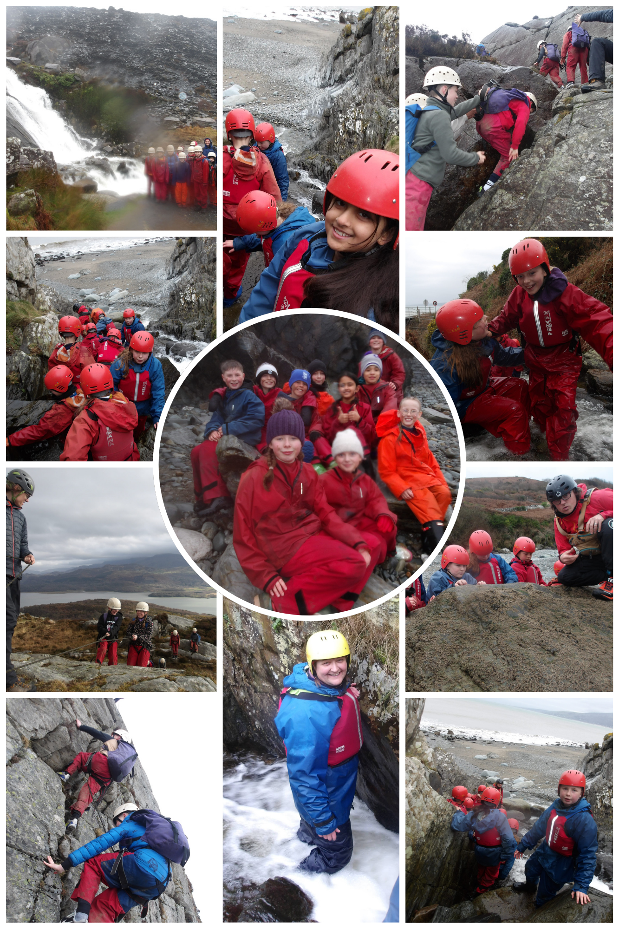
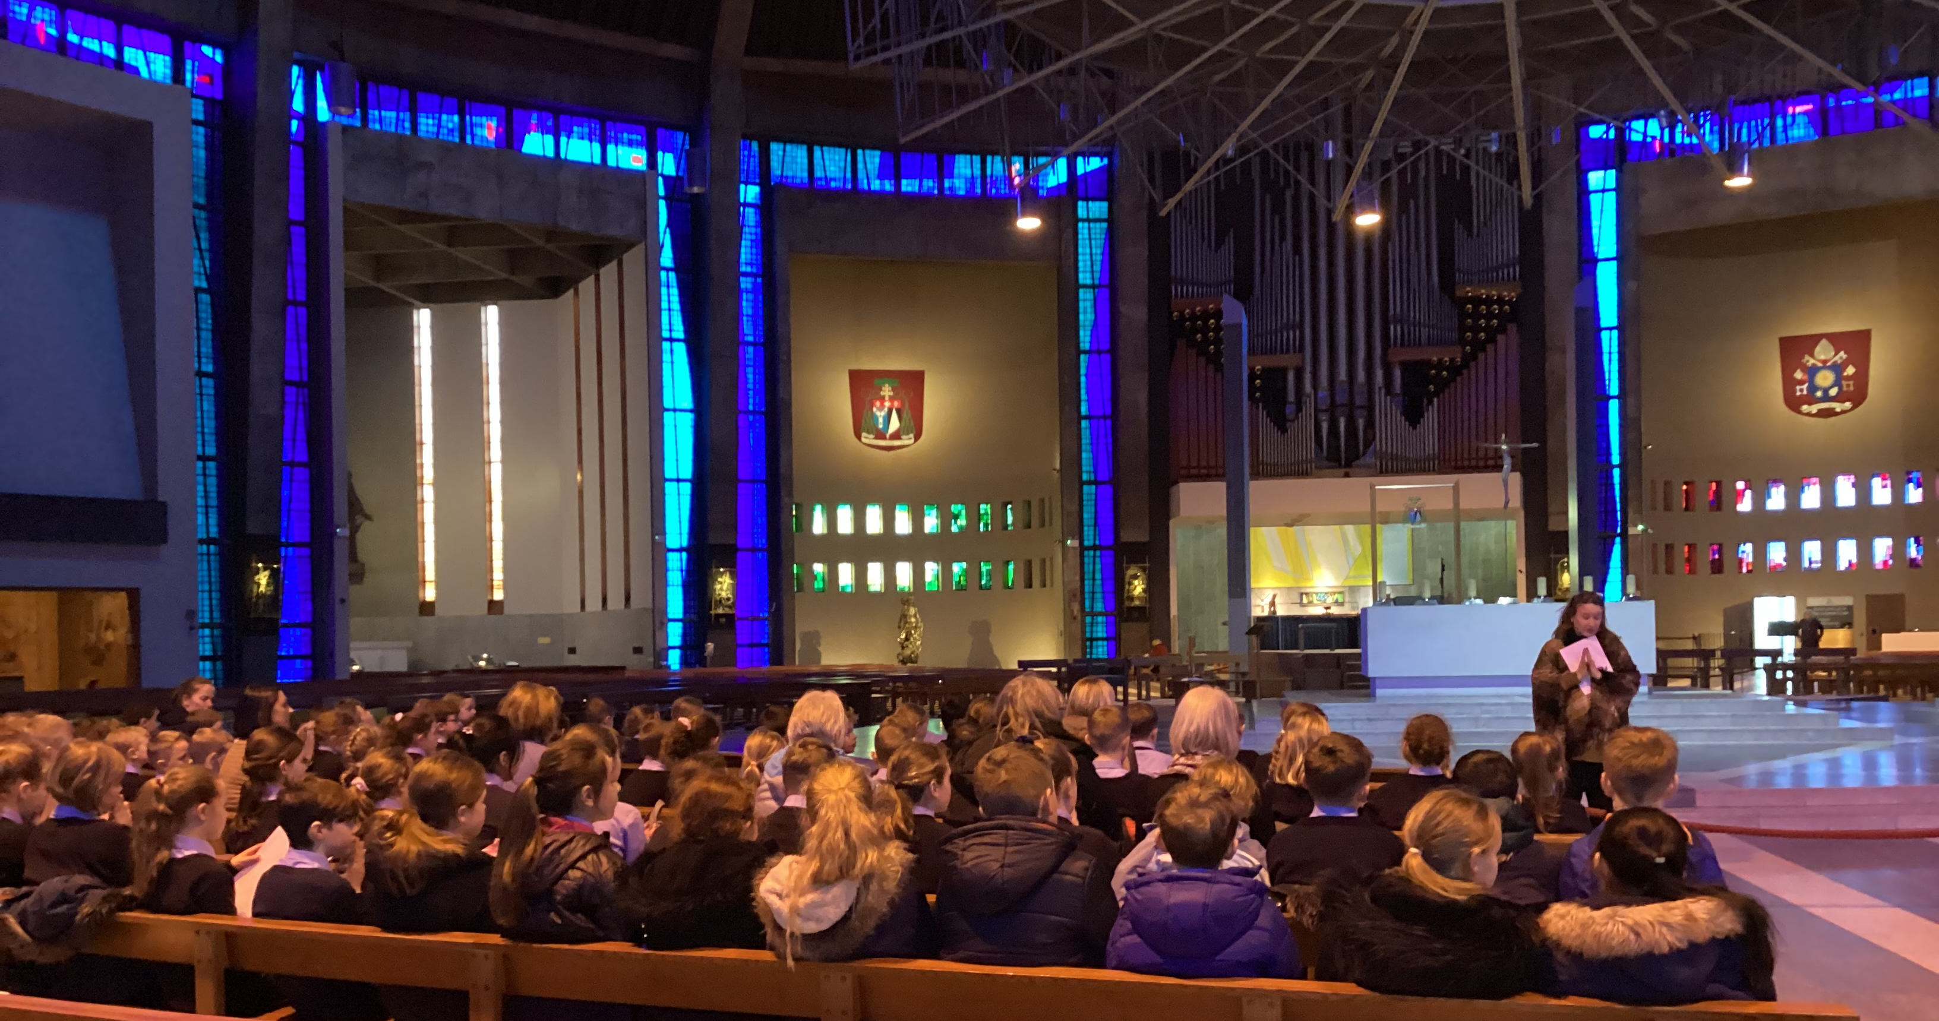
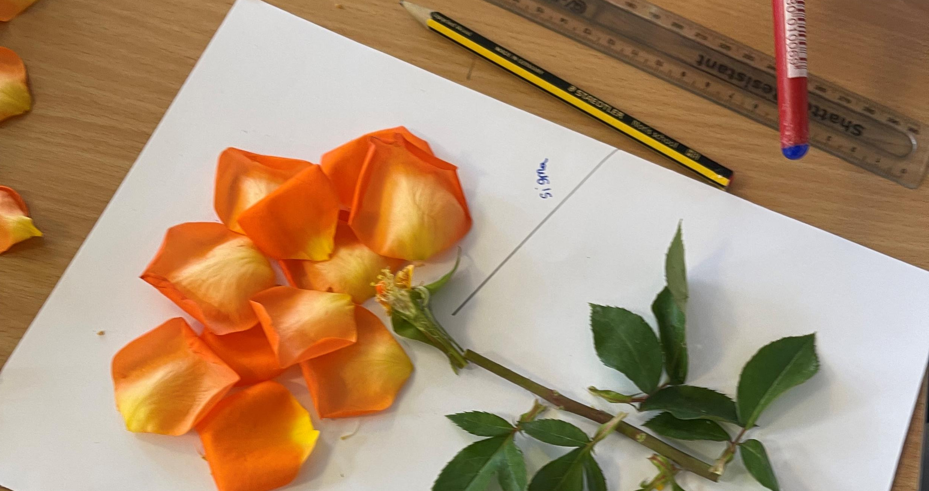
Meet the Teacher…
Welcome to Year 6

Slide 2

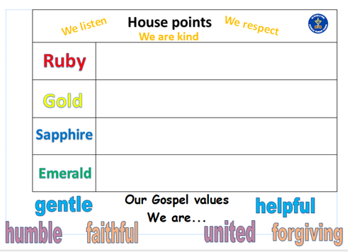
We use a Positive Behaviour policy
Our school values:
Sanctions:
The focus is on praising the behaviour we want to see.
Where sanctions are needed steps are taken with care and consideration, taking individual needs into account where necessary. We use a child-centred approach to discipline. What works for one child, may not work for another.
Rewards:
Your first point of call would be to speak to me or another member of Year 6 team in person or by telephone.
Please call the school office at the earliest opportunity to arrange a telephone conversation of F2F meeting.
If you prefer, please email me at sspp.year5@taw.org.uk

Slide 3
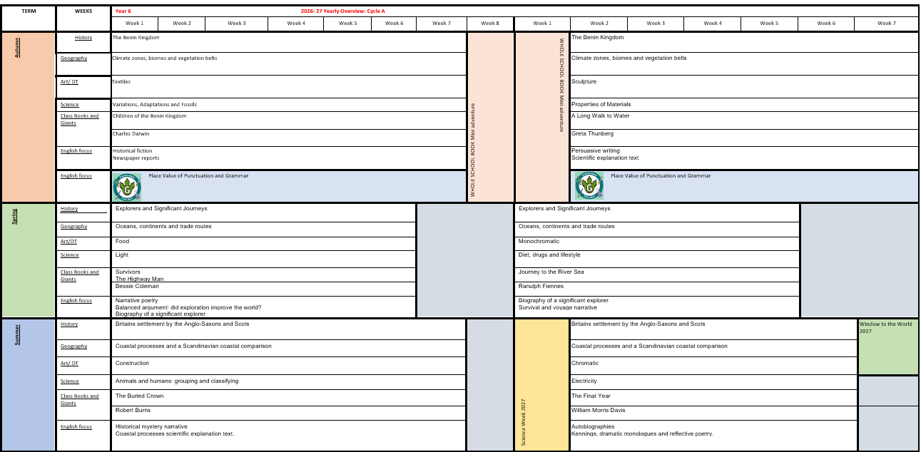

Slide 4
How has the curriculum changed? :
Standalone history and geography instead on mini adventure – new topics introduced in KS2
In MFL, French has replaced Spanish in KS2
Handwriting scheme introduced across the school
Spelling scheme introduced in KS2 which follows on ELS phonics in KS1

Slide 5


Reading in school and at home
Importance of reading:
Children will be heard read in school during our ERIC reading sessions, but they should be heard read at home too. Please could you indicate if you have heard your child read at home by signing their reading diaries.

Slide 6
Homework:
Weekly homework set on Mathletics
Spellings will remain in school
Reading to be completed at home.
KIRFS – Key instant recall facts- which will be sent home to you and are available on the school website.

Slide 7



E-safety, online usage and devices
https://www.nspcc.org.uk/keeping-children-safe/online-safety/

Slide 8
Assessment – formative and summative
Assessment in class:
Live marking and verbal feedback
Reading assessments
Spelling– completed in school
Kahoot quizzes / End of unit assessments
SATs assessments completed every term under the instruction of the MAT.
Daily Retrieval questions in maths remembering more and dealing with misconceptions. – has learning been embedded.
Prior learning questions and tasks in all lesson for re-call past learning.

Slide 9

Arthog
22nd -26th February 2027
Parent meeting to take place following the Christmas holidays
Arbor consent and non-refundable deposit of £50 by end of September.

Slide 10

Enterprise

