Slide 1
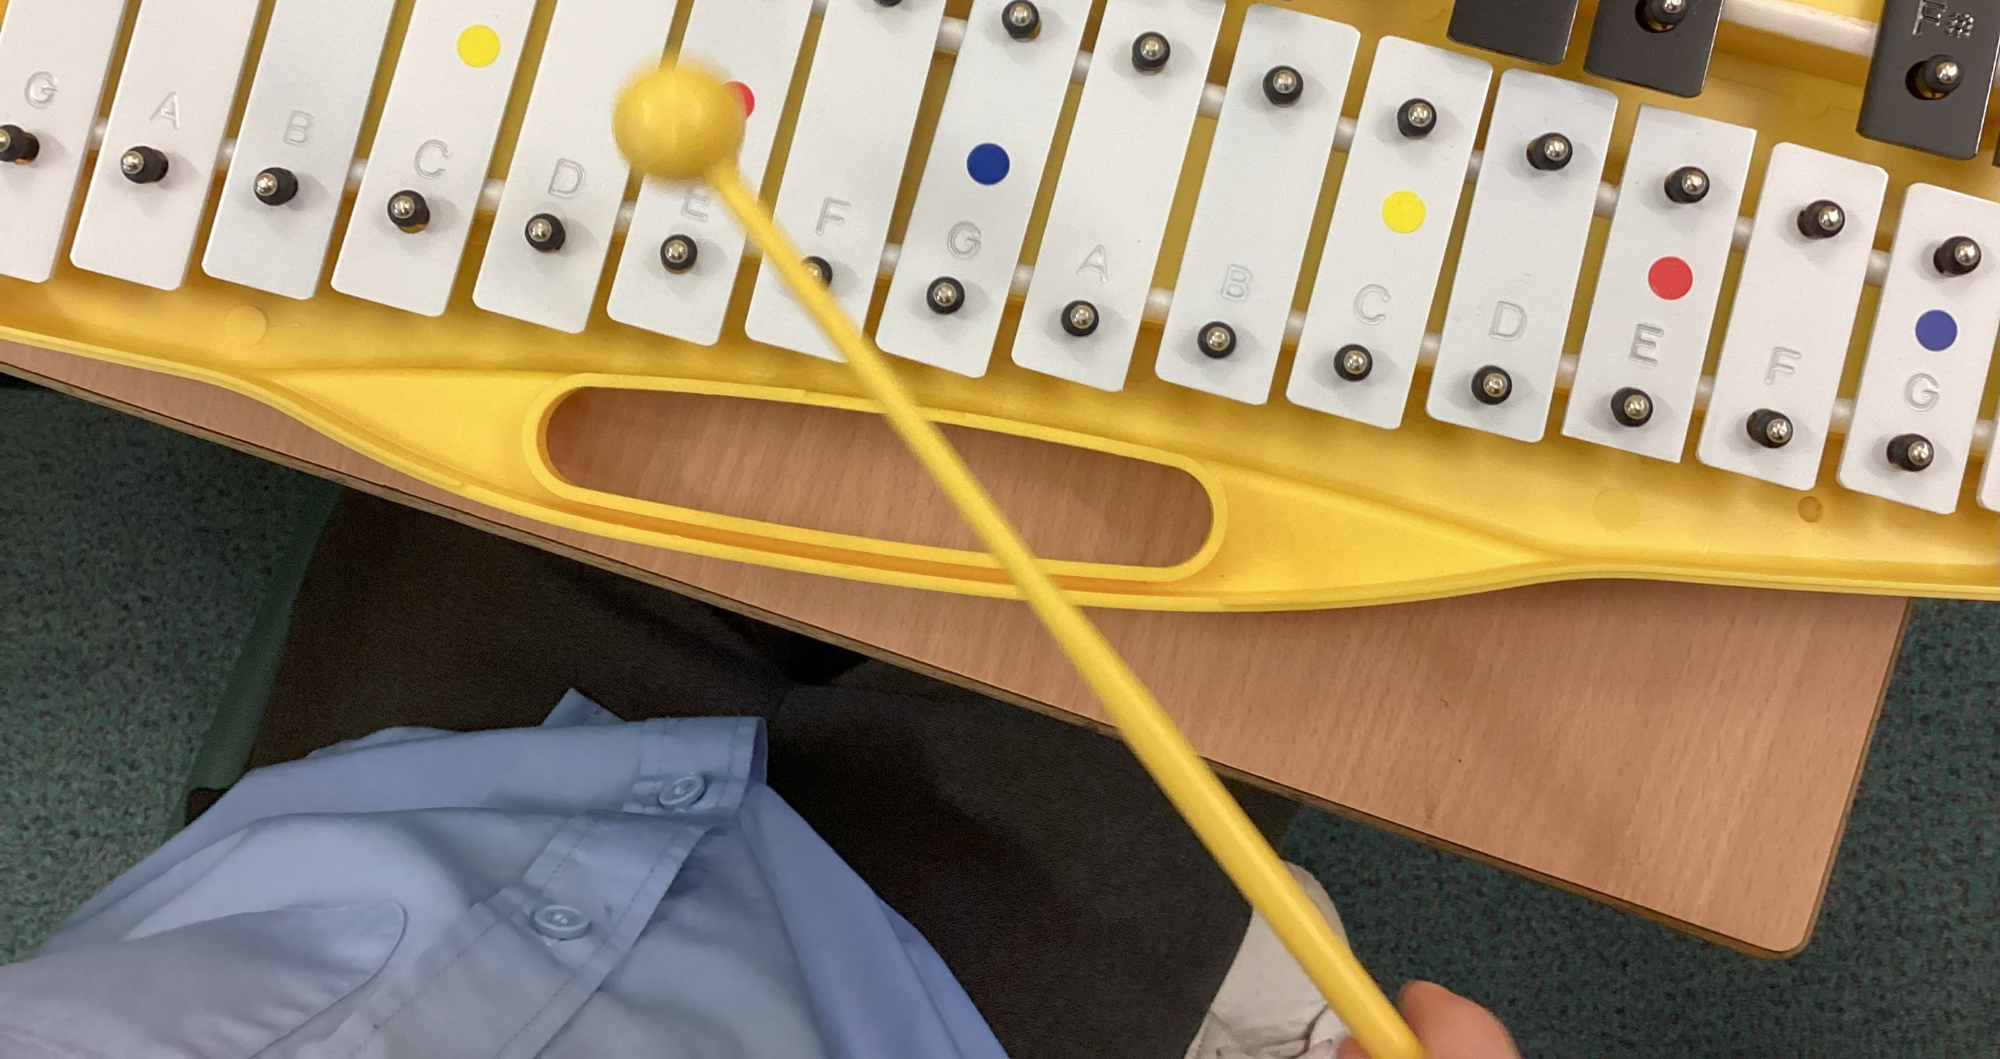
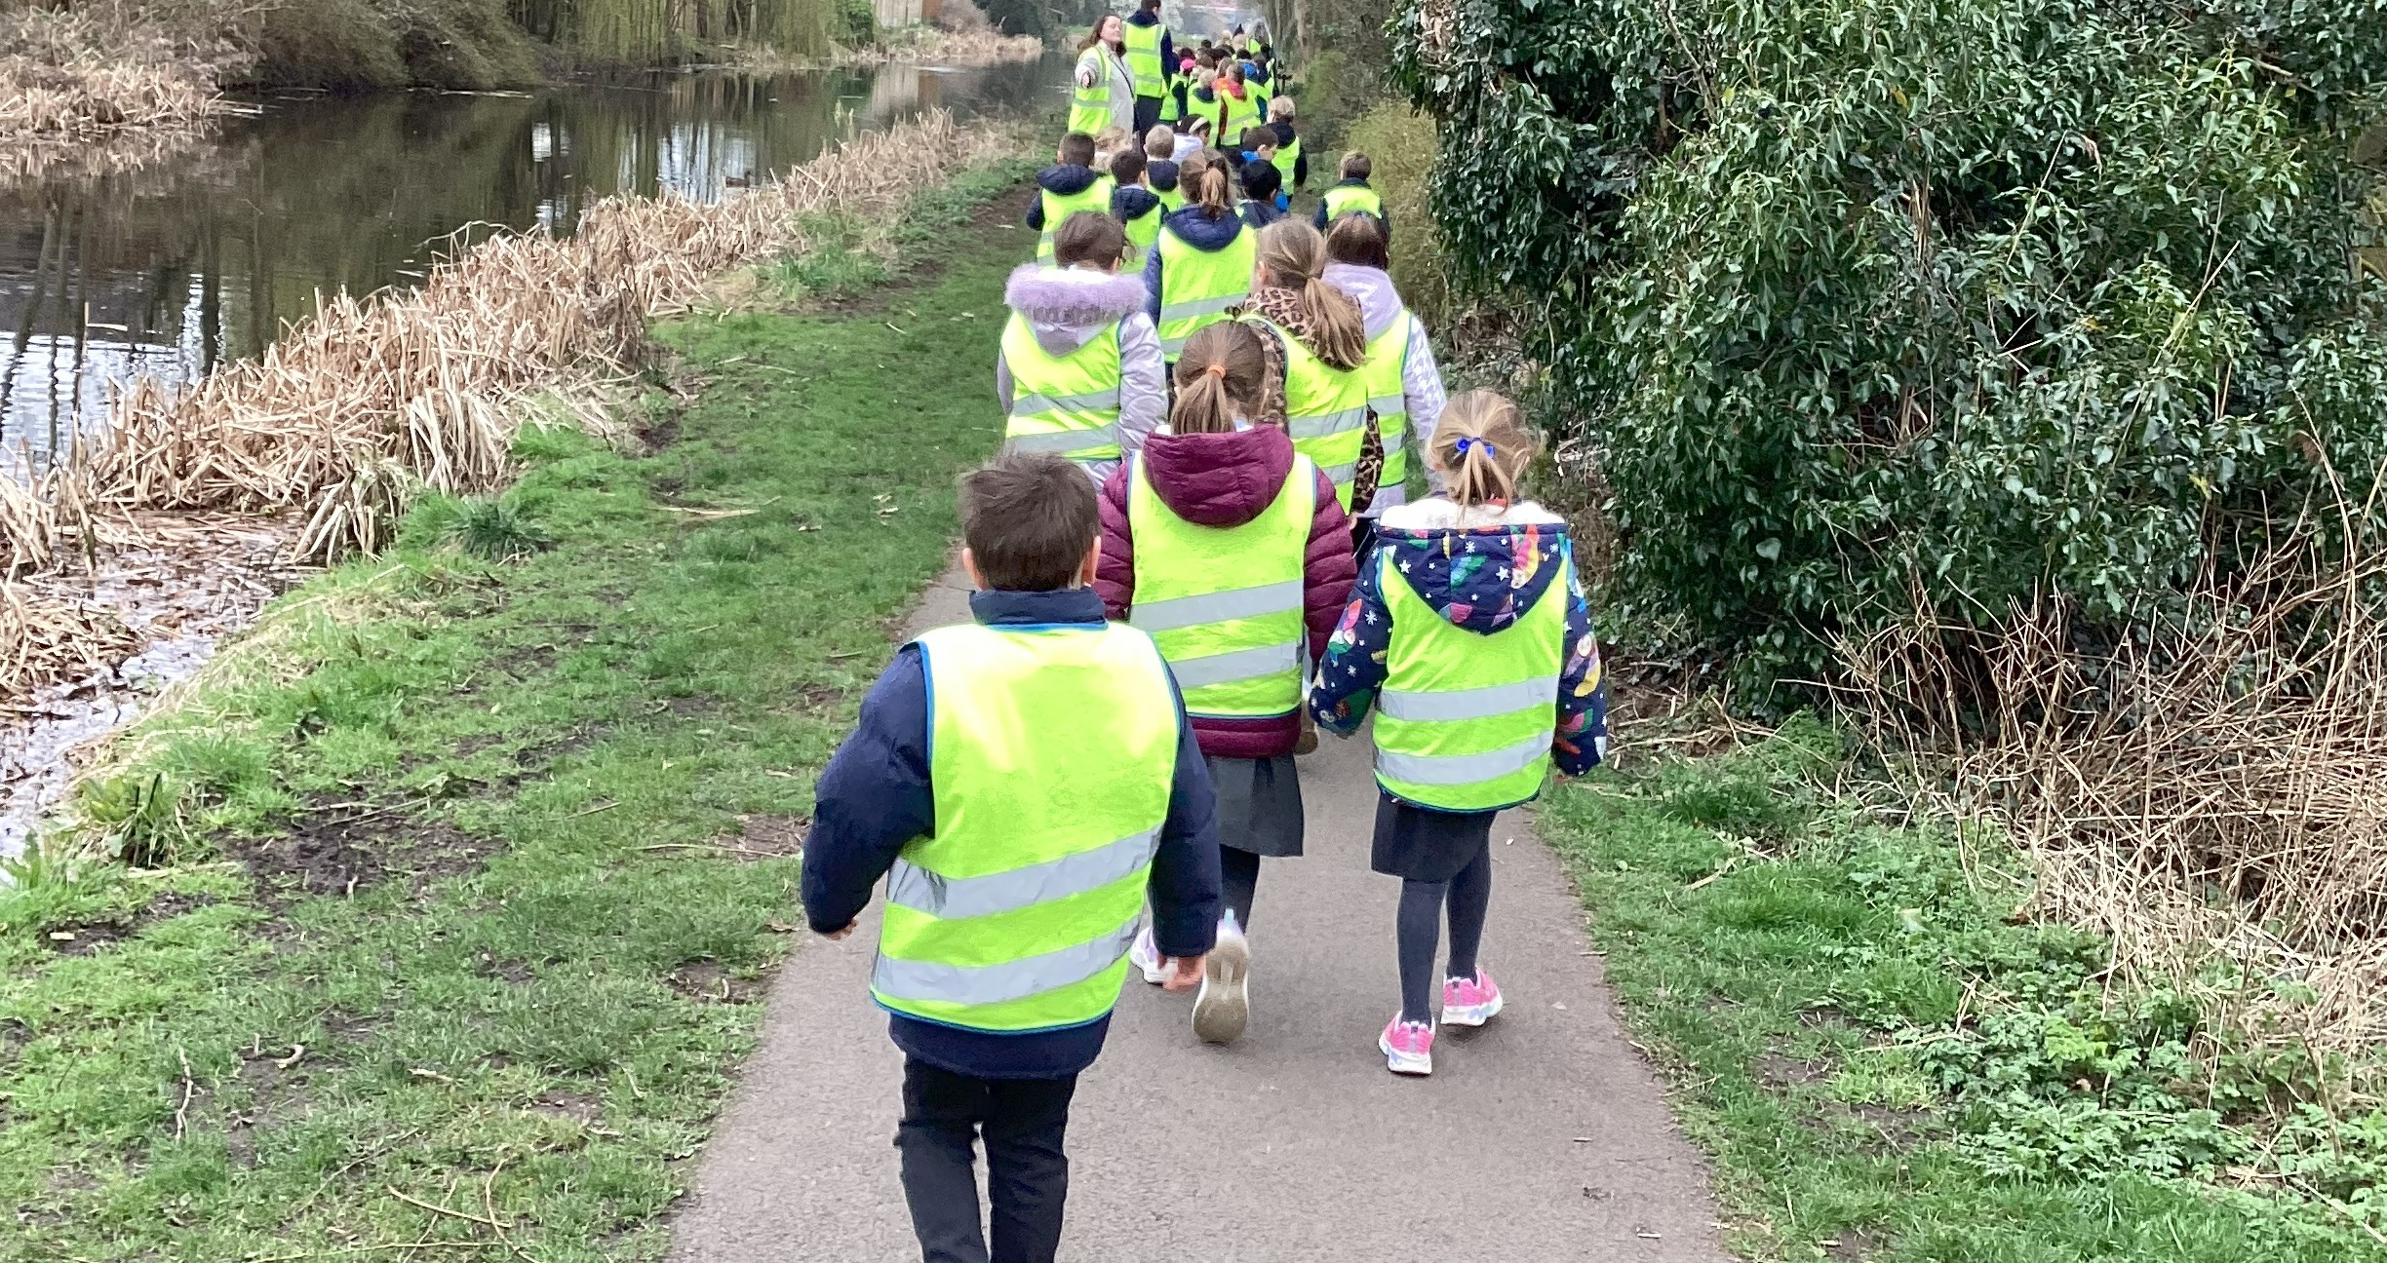

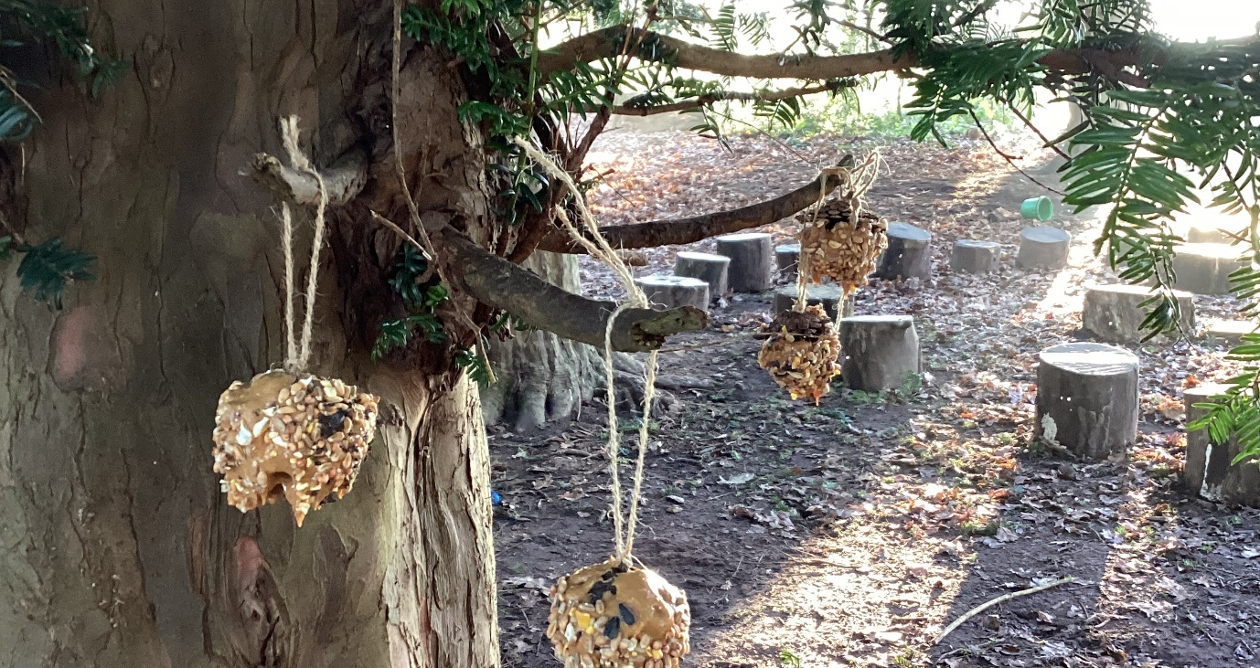
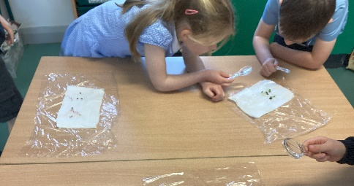
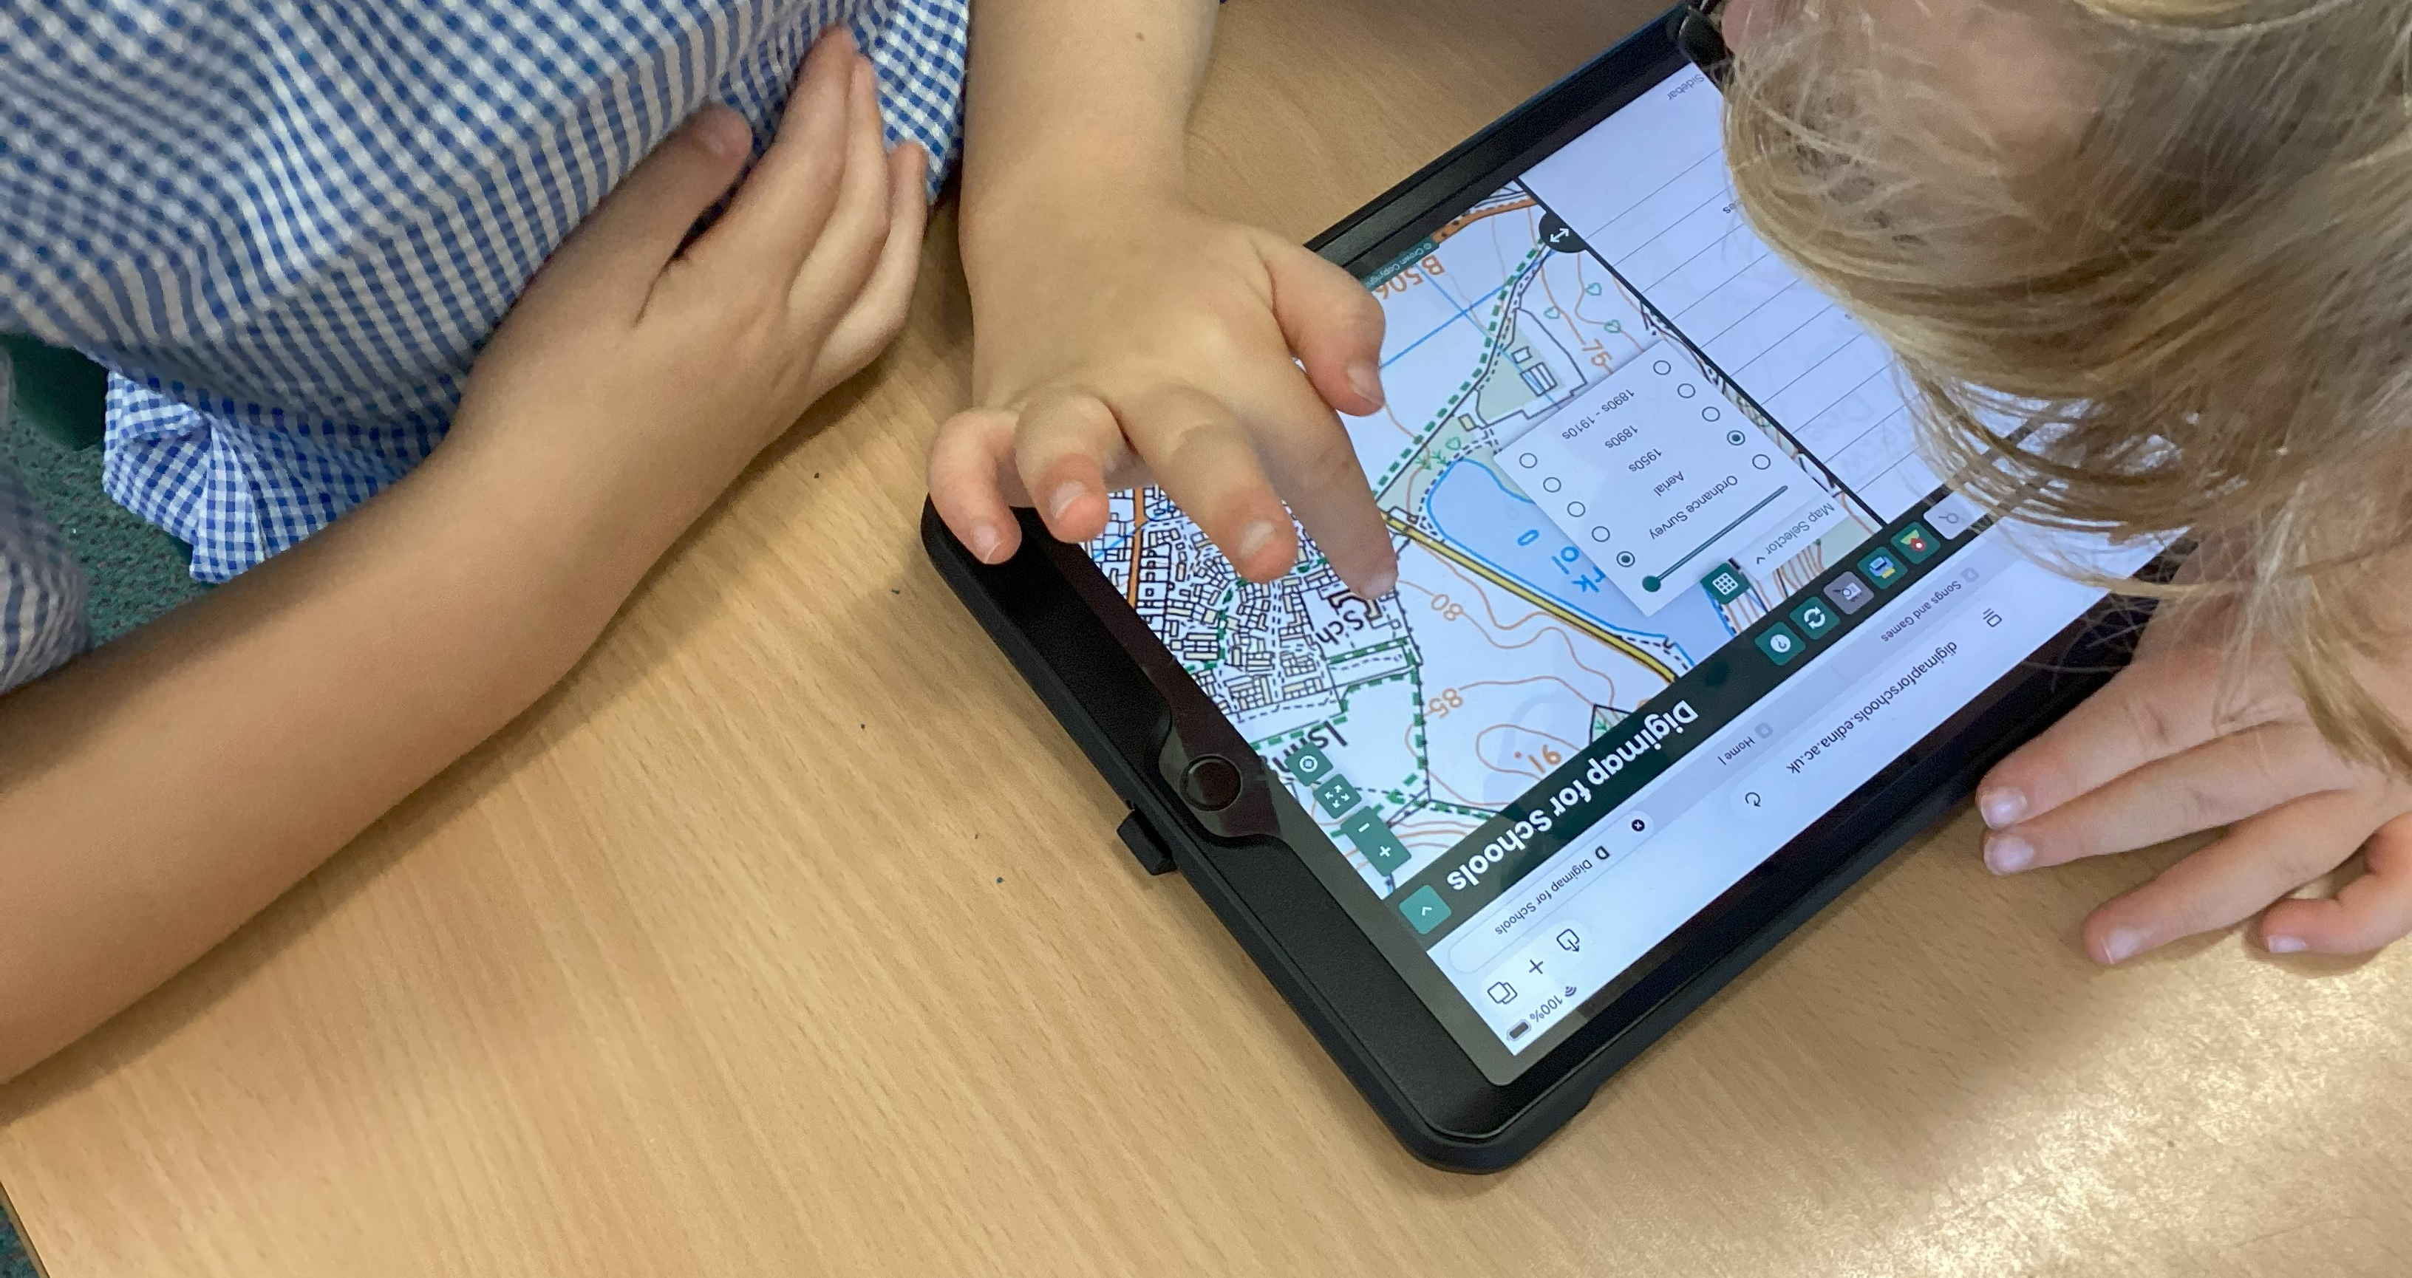
Meet the Teacher…
Welcome to Year 2

Slide 2

Our Mission statement

Slide 3

Our School Values

Slide 4

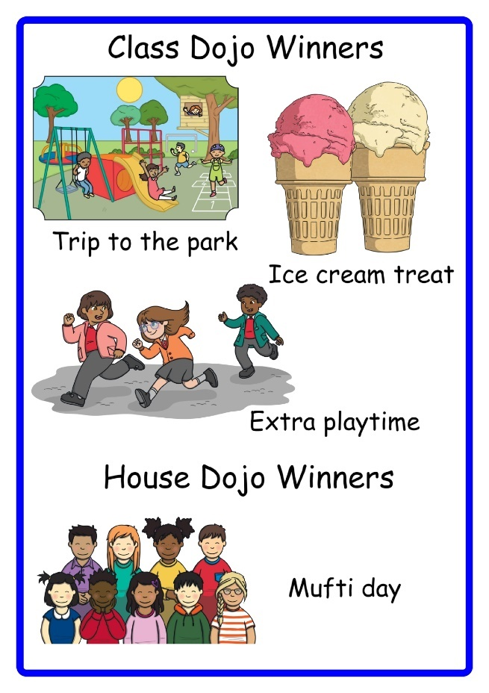
We use a Positive Behaviour policy
Our school values:
Sanctions:
The focus is on praising the behaviour we want to see.
Where sanctions are needed steps are taken with care and consideration, taking individual needs into account where necessary. We use a child-centred approach to discipline. What works for one child, may not work for another.
Rewards:

Slide 5
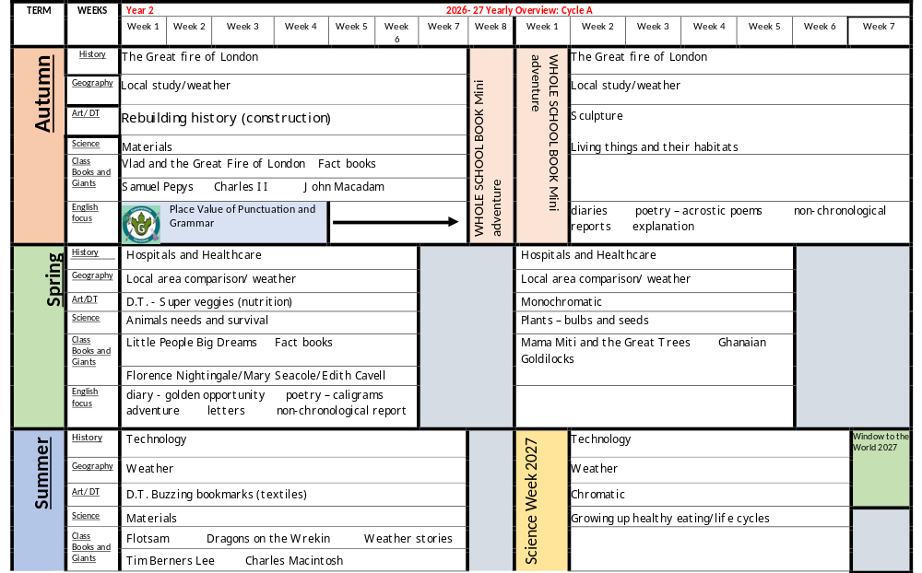

An overview

Slide 6
How has the curriculum changed? :
Standalone history and geography instead of mini adventure
Handwriting scheme introduced across the school
Spelling scheme in Year 2 follows on from the ELS phonics in EYFS, Reception and Year 1.

Slide 7


Reading in school and at home
School
At Home
We will endeavour to hear every child read individually each week.
The children read daily as part of our synthetic spelling lessons – sounding and blending using grapheme phoneme correspondence.
Guided reading will also start to take place as part of our reading lessons. Our focus in Year 2 is on fluency, expression, vocabulary, prediction and comprehension.
Regular assessment will take place to pitch reading books.
We have reading support from the Beanstalk scheme with Mrs Curbishley on a Tuesday and Thursday.
We encourage the children to read to an adult 5 times a week. Just a couple of pages a night is fine.
Re-reading a text is important when improving fluency and comprehension skills.
Using expression makes the text come alive.
Encourage the children to ask when not sure of a word, vocabulary understanding is important when comprehending what has been read…
… reading is so much more than just decoding the text.

Slide 8
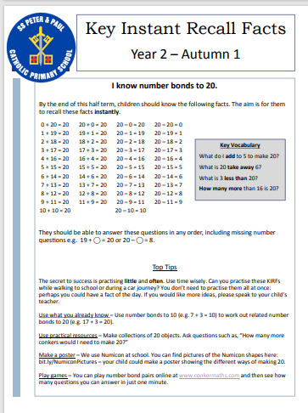
Homework:
Weekly homework set on Mathletics
Spellings will remain in school
Reading to be done at home.
KIRFS – Key instant recall facts- which will be sent home to you and are available on the school website.

Slide 9



E-safety, online usage and devices
https://www.nspcc.org.uk/keeping-children-safe/online-safety/

Slide 10
Assessment – formative and summative
Assessment in class:
Live marking and verbal feedback
Reading assessments
Spelling weekly/ dictation – done in school
End of unit assessments
End of term assessments
Daily Retrieval questions in maths remembering more and dealing with misconceptions. – has learning been embedded.
Prior learning questions and tasks in all lesson for re-call of prior learning.

Slide 11
Year 2 information
Reading folders in school every day.
Water bottles
Please name all items of clothing.
PE – is on a Monday and a Wednesday this term – we will be doing PE outside on one of the sessions so please make sure that the children have some form of pumps/trainers.
School lunches
Email the class email is
Sspp.year2@taw.org.uk

Slide 12


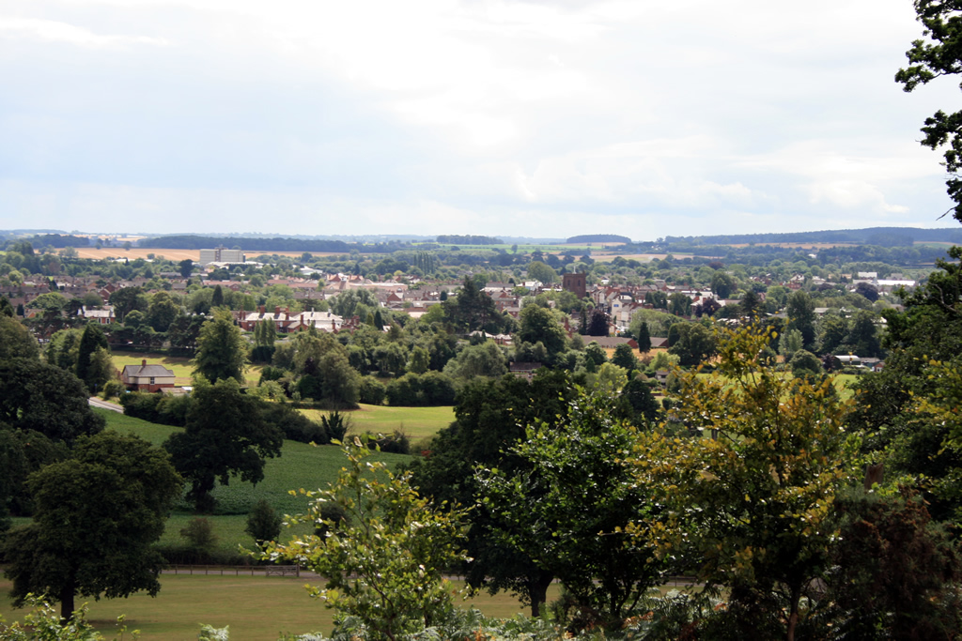
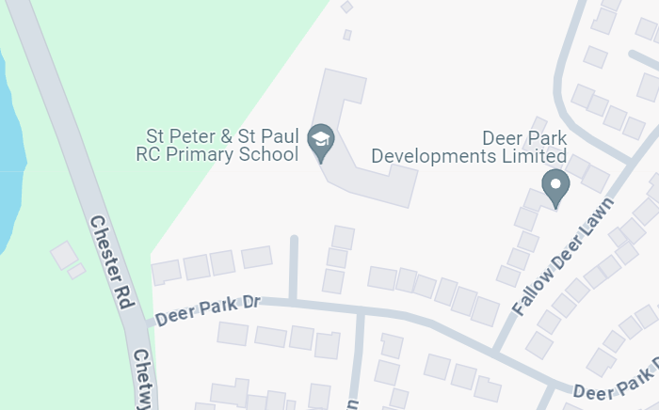
Suggested Trips for this year…
Pantomime/ theatre visit
Our immediate environment.
A trip into Newport.
Whole school trip …
As with everything these are subject to change at short notice so please wait for the notification letter before telling the children.

Slide 13

Any questions?

